Slide 1

Data mining assignment 2
Anna Henson

Slide 2
Weather trends
collection
processing
Results

Slide 3

Problem Statement
Problem is does the data show a correlation between temperature, humidity and the wind.

Slide 4
System Design

Slide 5
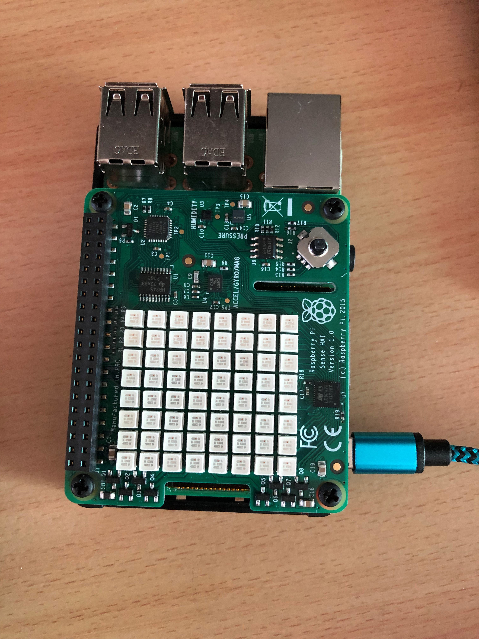
The hardware
8*8 LED display
Temperature and humidity sensor
Air pressure sensor
Microsoft Surface Pro i5 8GB memory

Slide 6
Data collection

Slide 7
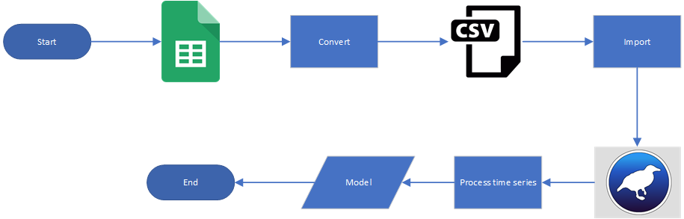
Data Processing

Slide 8
Procedure for
experiments

Slide 9

Supervised vs Unsupervised
“The steps that are considered to shift the data backward in the time(sequence), called lag times or lags. Therefore, a time series problem can be transformed into a supervised ML by adding lags of measurements as inputs of the supervised ML”
https://towardsdatascience.com/time-series-machine-learning-regression-framework-9ea33929009a
This Photo by Unknown Author is licensed under CC BY-SA

Slide 10
Time series processing Linear regression
Parameter | Value
Evaluation | MSE, RMSE
Evaluate on training | True
Evaluate on held out training | 0.3
Minimum Lag (Hours) | 72
Maximum Lag (Hours) | 72
Number of time units to forecast | 72
Graph predictions at step | 1
Graph target at steps | 1, Outside temp
Graph future predictions beyond end of series | True

Slide 11
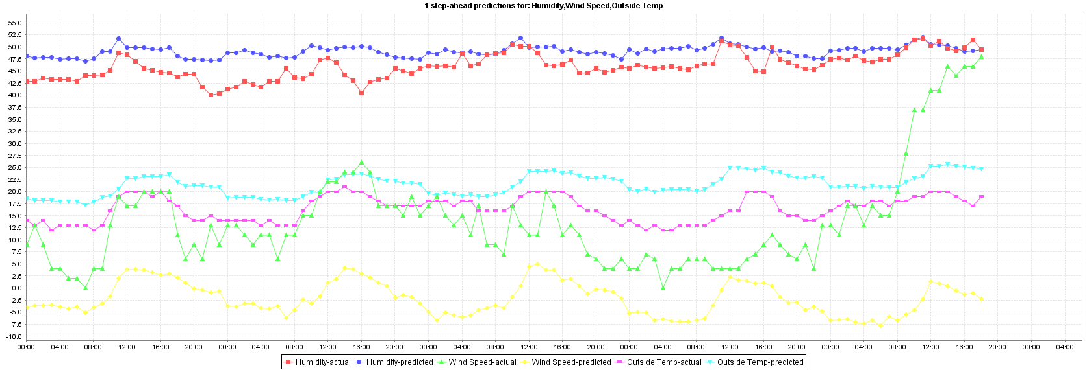
Linear regression 1 step ahead Actual vs prediction

Slide 12
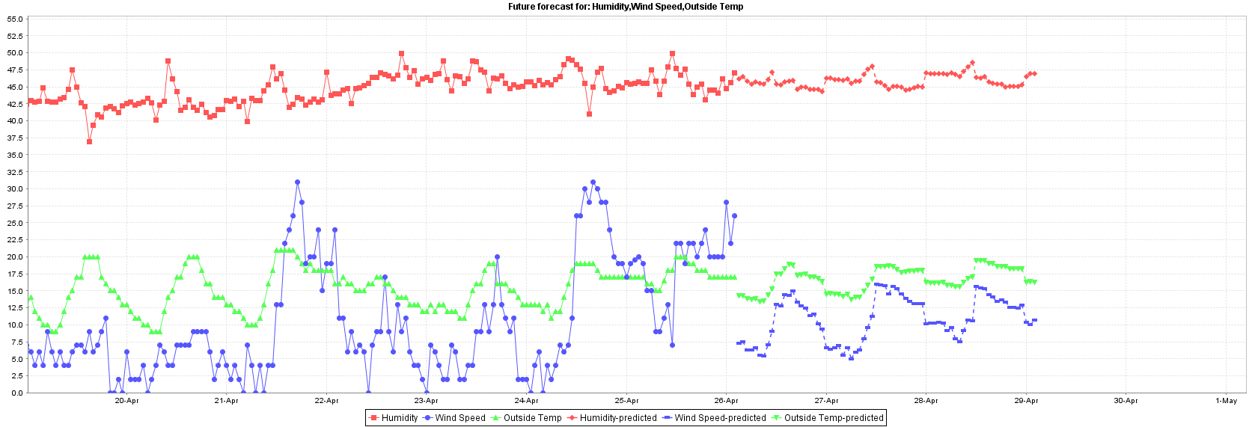
Linear regression predicted on training data

Slide 13
Linear regression predicted on training data
Model Linear regression | Training(%) 1 step ahead | Testing(%) 1 step ahead
Outside temperature
N | 873 | 400
Mean absolute error | 1.539 | 3.9325
Root mean squared error | 1.9636 | 4.5356
Attribute selection method = No attribute selected
Model Linear regression | Training(%) 1 step ahead | Testing(%) 1 step ahead
Outside temperature
N | 873 | 400
Mean absolute error | 1.5394 | 3.9067
Root mean squared error | 1.9633 | 4.4973

Slide 14
Time series processing SMOreg
Same parameters as linear regression have been used.

Slide 15
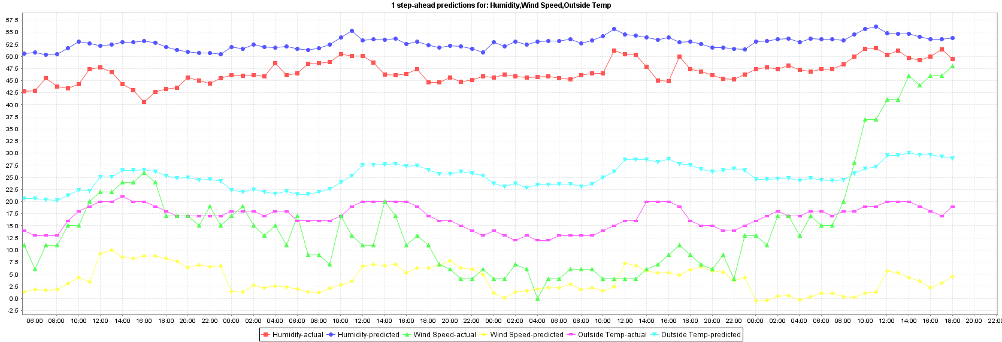
SMOreg 1 step ahead Actual vs prediction

Slide 16
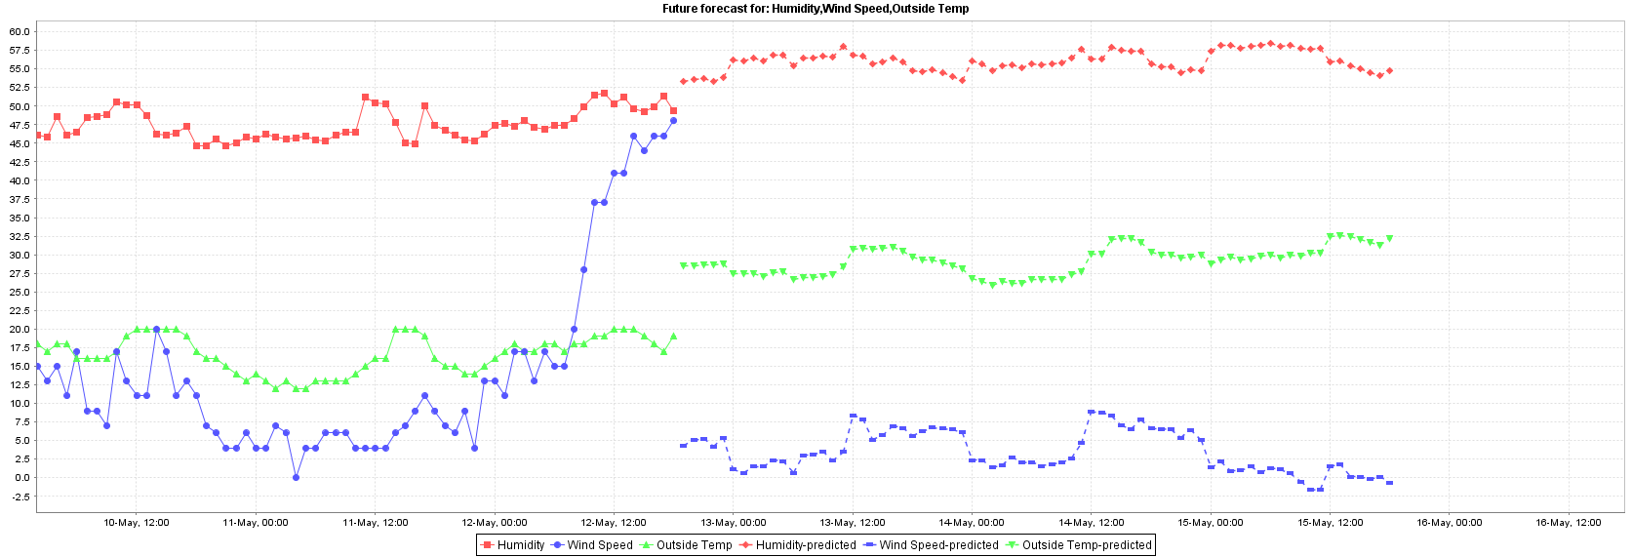
SMOreg predicted on training data

Slide 17
SMOreg predicted on training data
C = 1
Model SMOreg | Training(%) 1 step ahead | Testing(%) 1 step ahead
Outside temperature
N | 873 | 400
Mean absolute error | 1.5157 | 5.4416
Root mean squared error | 1.9467 | 6.199

Slide 18
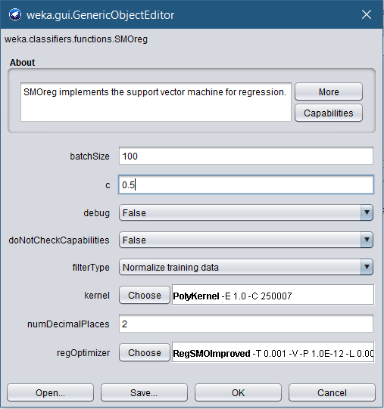
Time series processing SMOreg Lower complexity
Same parameters as linear regression have been used, except for the complexity set to 0.5

Slide 19
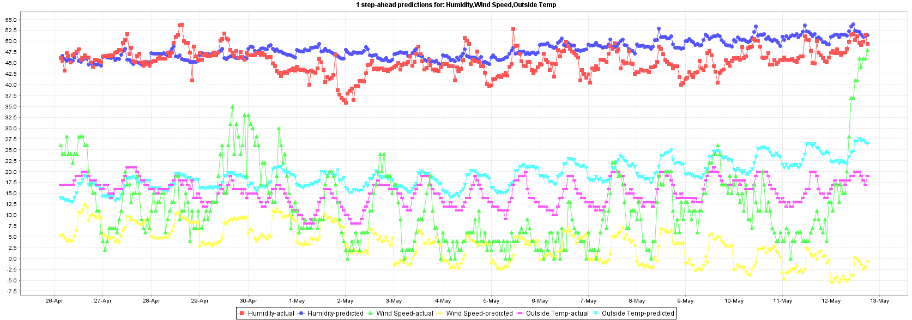
SMOreg 0.5 1 step ahead Actual vs prediction

Slide 20
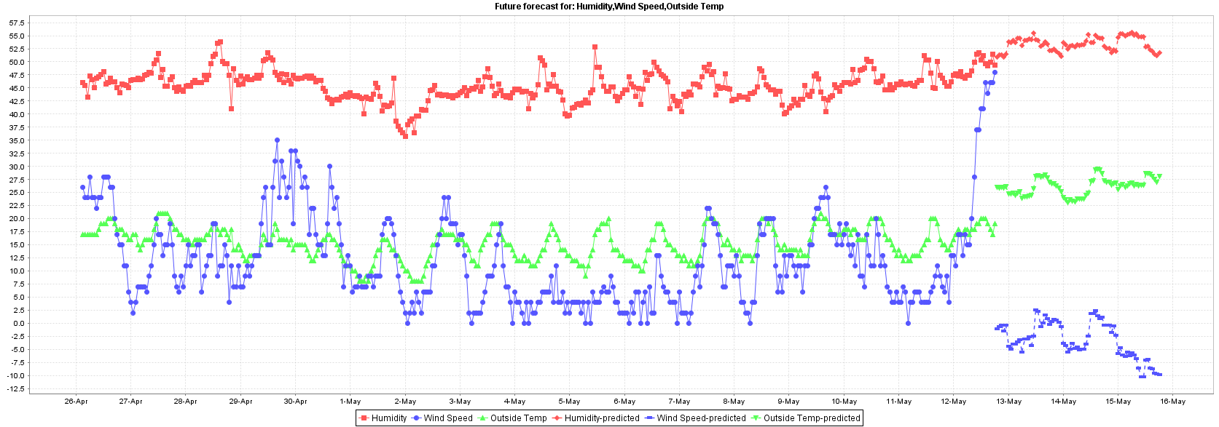
SMOreg 0.5 predicted on training data

Slide 21
SMOreg 0.5 predicted on training data
C = 0.5
Model SMOreg | Training(%) 1 step ahead | Testing(%) 1 step ahead
Outside temperature
N | 873 | 400
Mean absolute error | 1.524 | 4.338
Root mean squared error | 1.9594 | 4.9981

Slide 22
Random Tree
Same parameters as linear regression have been used

Slide 23
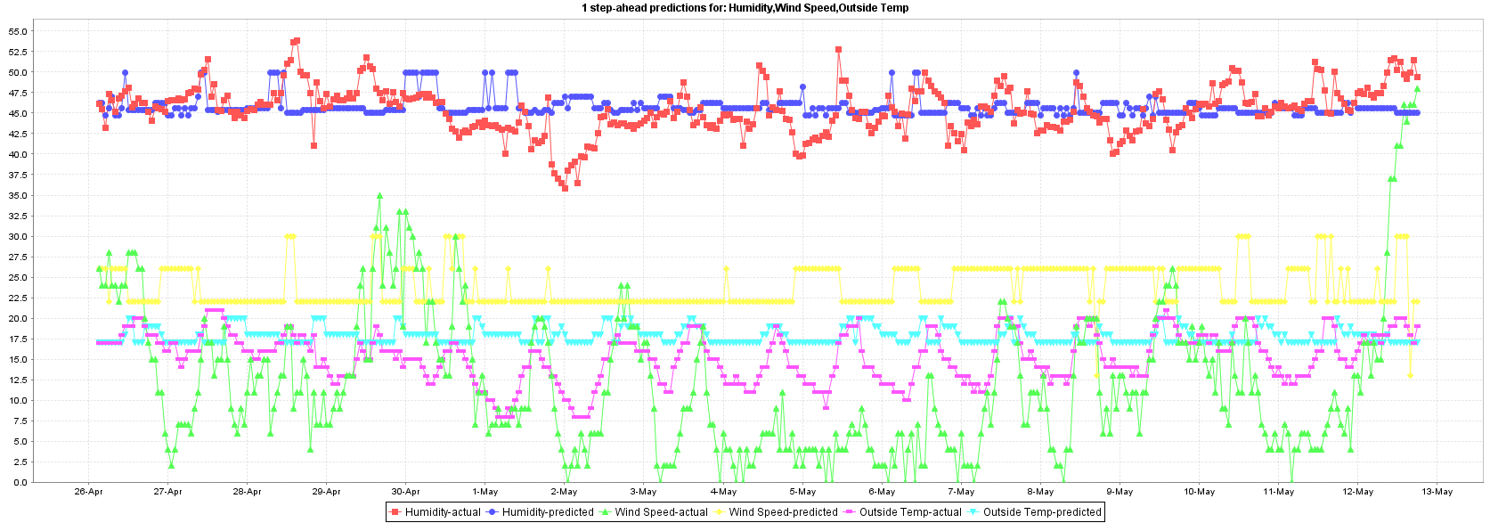
Random Tree 1 step ahead Actual vs prediction

Slide 24
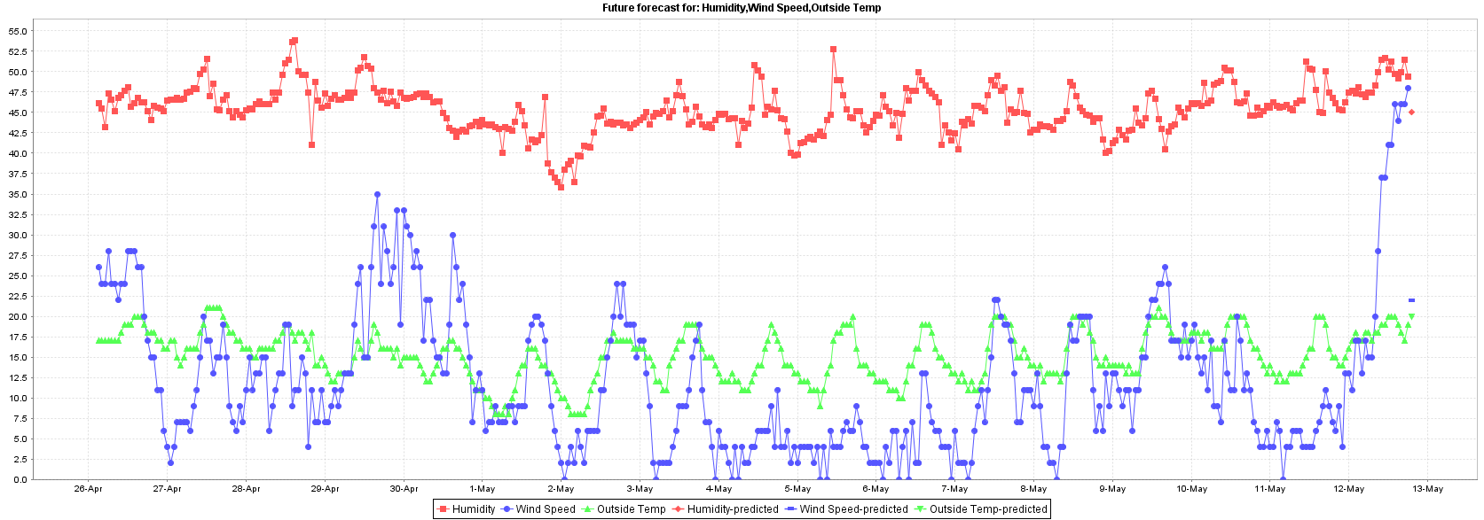
Random Tree predicted on training data

Slide 25
Random Tree predicted on training data
Model Random tree | Training(%) 1 step ahead | Testing(%) 1 step ahead
Outside temperature
N | 873 | 400
Mean absolute error | 0.0069 | 3.23
Root mean squared error | 0.1057 | 3.9357

Slide 26
Results of testing data
Temperature
Classifier | Mean absolute error | Root mean squared error
Linear regression | 3.9325 | 4.5356
Linear regression - tuned | 3.9067 | 4.4973
SMOreg C = 1 | 5.4416 | 6.199
SMOreg C = 0.5 | 4.338 | 4.9981
Random tree seed = 1 | 3.23 | 3.9357
Random tree seed = 2 | 2.69 | 3.3679

Slide 27
Results of testing data
Humidity
Classifier | Mean absolute error | Root mean squared error
Linear regression | 2.7039 | 3.4378
Linear regression - tuned | 2.6852 | 3.4181
SMOreg C = 1 | 4.1831 | 4.9625
SMOreg C = 0.5 | 3.3442 | 4.0695
Random tree seed = 1 | 2.3672 | 3.1164
Random tree seed = 2 | 2.4255 | 3.1153

Slide 28
Results of testing data
Wind speed
Classifier | Mean absolute error | Root mean squared error
Linear regression | 8.664 | 12.1767
Linear regression - tuned | 8.664 | 12.1767
SMOreg C = 1 | 7.3206 | 10.5779
SMOreg C = 0.5 | 9.1686 | 12.4279
Random tree seed = 1 | 13.1425 | 14.7744
Random tree seed = 2 | 13.085 | 14.9355

Slide 29
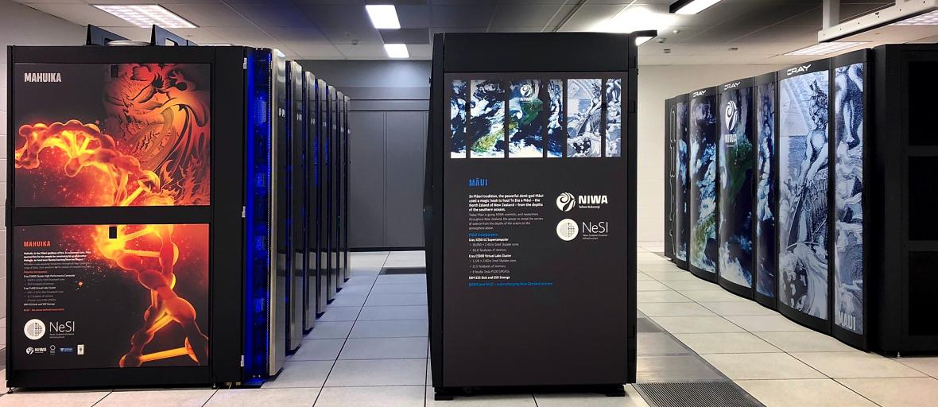
What Niwa use
 | Māui | Mahuika | Kupe | Mine
Type | Cray XC50-LC Supercomputer | Cray CS400 Cluster High Performance Computer | Cray XC50-AC Supercomputer | I9-9900K
Cores | 18,650 × 2.4GHz Intel Skylake core | 8,424 × 2.1GHz Intel Broadwell cores | 4,160 × 2.4GHz Intel Skylake cores | 8 x 3.6GHz
Memory | 66.8 Terabytes | 12.3 Terabytes | 10 Terabytes | 32 Gigabytes

Slide 30
Future improvements
Collect over a longer period.
Use historic data.
Use a better device to collect the data.
Compare to a different geographical area.

Slide 31

Thank You
Anna henson

